Slide 1

Traffic Sign Classification for Autonomous Driving
Talha Mahmood Chaudhry

Slide 2

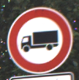


Goal/Scope
What was my Problem?
To Classify Traffic Signs
Sub-Task for Autonomous Driving
Tasks Performed
Extracted Features from RGB (not Greyscale) images
Trained a CNN on 76% Dataset
Evaluated Performance on the remaining 24%
Example Images (GTSRB) [1]
^{[1]} J. Stallkamp, M. Schlipsing, J. Salmen, and C. Igel. The German Traffic Sign Recognition Benchmark: A multi-class classification competition. Proceedings of the IEEE International Joint Conference on Neural Networks, pages 1453–1460. 2011

Slide 3
The Data [1]
Description
39,209 Training Images
12,630 Testing Images
43 Classes (Numbered 0 to 42)
Unequal Distribution and Size of Images
PreProcessing
Resizing of the Images (32X32X3)
Feature Extraction (Using Python)
Normalization
‘One-Hot Encoding’ of Classes
^{[1]} J. Stallkamp, M. Schlipsing, J. Salmen, and C. Igel. The German Traffic Sign Recognition Benchmark: A multi-class classification competition. Proceedings of the IEEE International Joint Conference on Neural Networks, pages 1453–1460. 2011

Slide 4
Lit Review
Foucher, et all (2010) [2]
Color and Shape
Proposed algorithm: ability to detect and recognize repetitive markings (such as crosswalks) as well as single patterns (such as arrows)
95% Crosswalk – 87% Arrows
Bruno, Diego & Osorio, Fernando (2017) [3]
An Adaptive Deep Learning System
97.24% Accuracy on GTSRB data
^{[2]} Foucher, Philippe & Tarel, et all. (2010). Road Sign Detection in Images : A Case Study. ICPR'10, pp. 488-498.
^{[3]} Bruno, Diego & Osorio, Fernando. (2017). Image classification system based on deep learning applied to the recognition of traffic signs for intelligent robotic vehicle navigation purposes. IEEE São Paolo 1-6.

Slide 5
Case Study [4]
Aghdam, Hamed, et all (2017) [4]
State-of-the-Art Solution on GTSRB Dataset
The Main Takeaways
“Leaky ReLU”
Multiple CNNs and Ensembling
Quality
Reduced Arithmetic Operations by 80%
99.07% Accuracy
98.6% Accuracy if Operations reduced by 95%
^{[4]} Aghdam, Hamed & Heravi, Elnaz & Puig, Domenec. (2017). A Practical and Highly Optimized Convolutional Neural Network for Classifying Traffic Signs in Real-Time. International Journal of Computer Vision. 122..

Slide 6
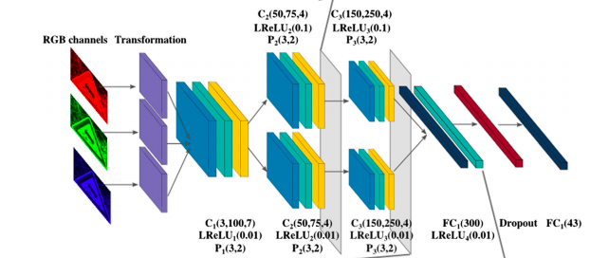
.. Case Study [4]
^{[4]} Aghdam, Hamed & Heravi, Elnaz & Puig, Domenec. (2017). A Practical and Highly Optimized Convolutional Neural Network for Classifying Traffic Signs in Real-Time. International Journal of Computer Vision. 122..

Slide 7
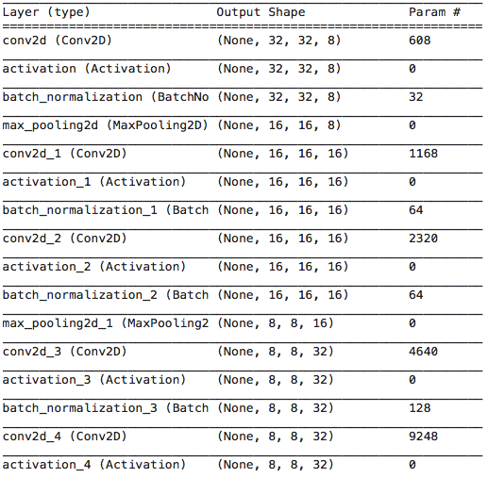
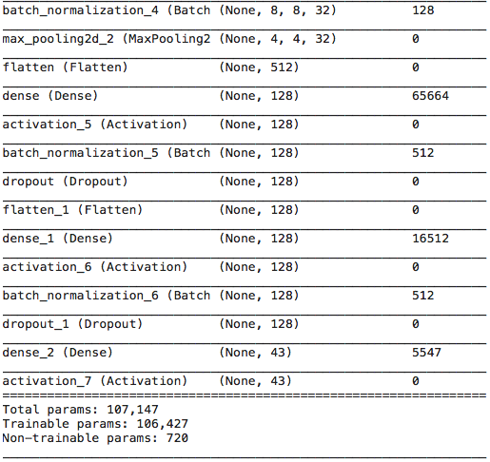
My CNN

Slide 8
My Deliverables
The Product
Trained CNN to classify RGB images of Traffic Signs as a subtask for Autonomous Driving.
Evaluation: Accuracy
Considered Acceptable if 92% Accuracy achieved
This was based on a list of Accuracy metrics of many papers mentioned in the Case Study (91% was the lowest)
94.6 % Accuracy (20 Epochs)
95.03% Accuracy (30 Epochs)

Slide 9
Thank You!

